Slide 1
QA – Hobby Project
Badul Chowdhury
April 22, 2022
Technology Consultant
Notes:
Line spacing + Page numbers

Slide 2
Agenda
Introduction
The Task
Planning
Tools Used
Approach
SQL - MVP
HTML, CSS, JavaScript
Java
Challenges
Summary

Slide 3
Introduction
Passion outside of work for…
Technology
Art
Design
Fashion

Slide 4
The Task
Tools and methodologies
Jira
Java
MySQL
HTML
CSS
JavaScript
Create an application that
Creates
Reads
Updates
Deletes
Items to/from a database

Slide 5
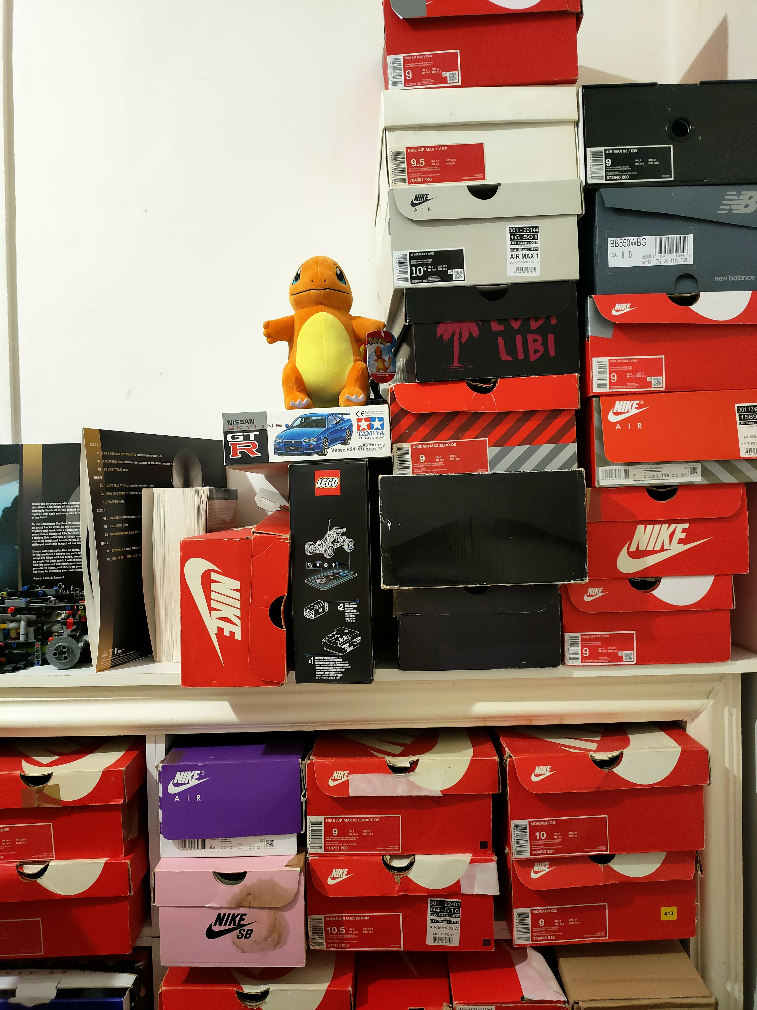
Planning
Around 10% of my total collection
As an avid sneaker collector I have chosen to create my application based on this
Helps me manage my current collection where data can persist on a database
I have also had a successful depop store accumulating around 5,000 followers
- My application could be used to also manage my inventory, sales figures and allow me to keep a record of customers taken some small changes are done to my input fields

Slide 6
Planning Tools used
Around 10% of my total collection
The tools I used for planning my project is known as Jira. This is a project management software that allowed me to successfully create and track the development of my project.
Jira is widely used in agile software development which is the software development methodology I have used in creating my application

Slide 7
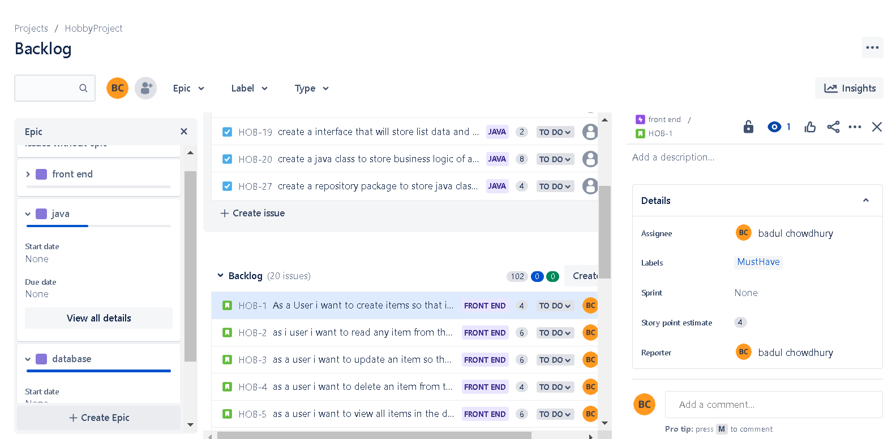
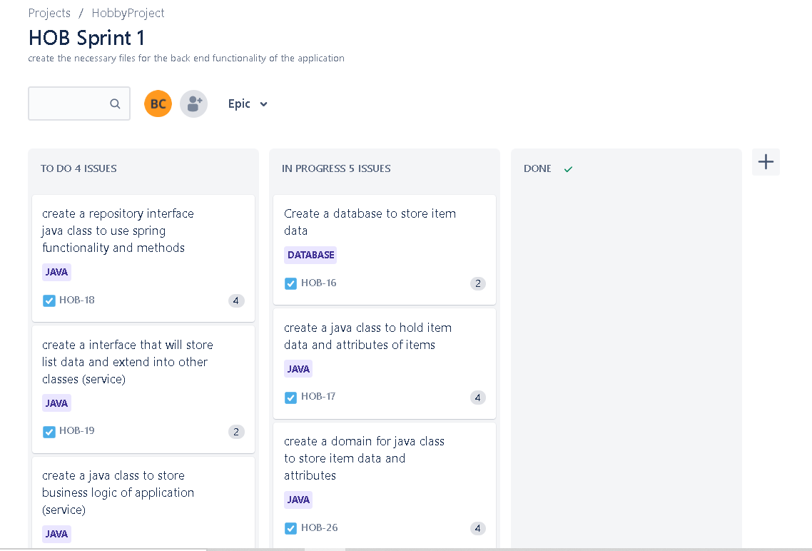
Approach - planning

Slide 8
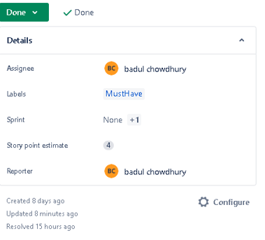
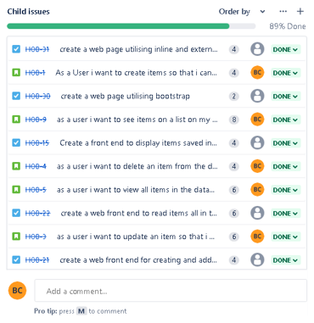
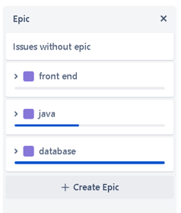
Approach - planning

Slide 9
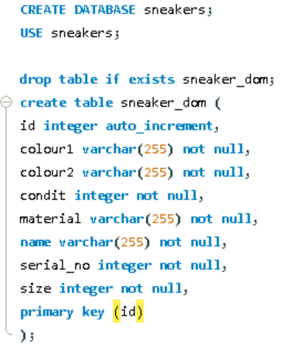
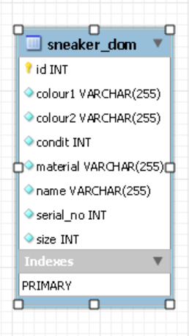
SQL MVP
I created a database and a table to store the information that will be created by users/myself

Slide 10
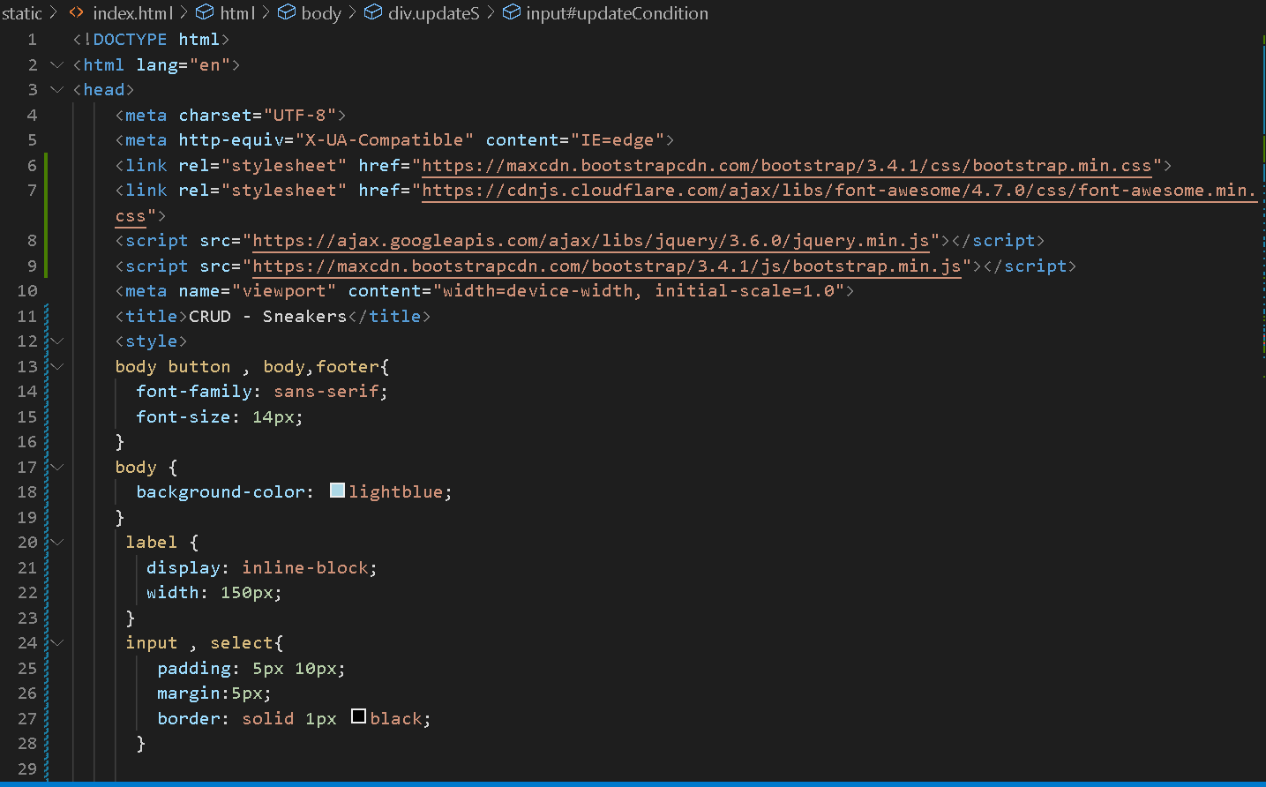
HTML – CSS
I used CSS to style my front end as well as utilising bootstrap elements in my front end

Slide 11
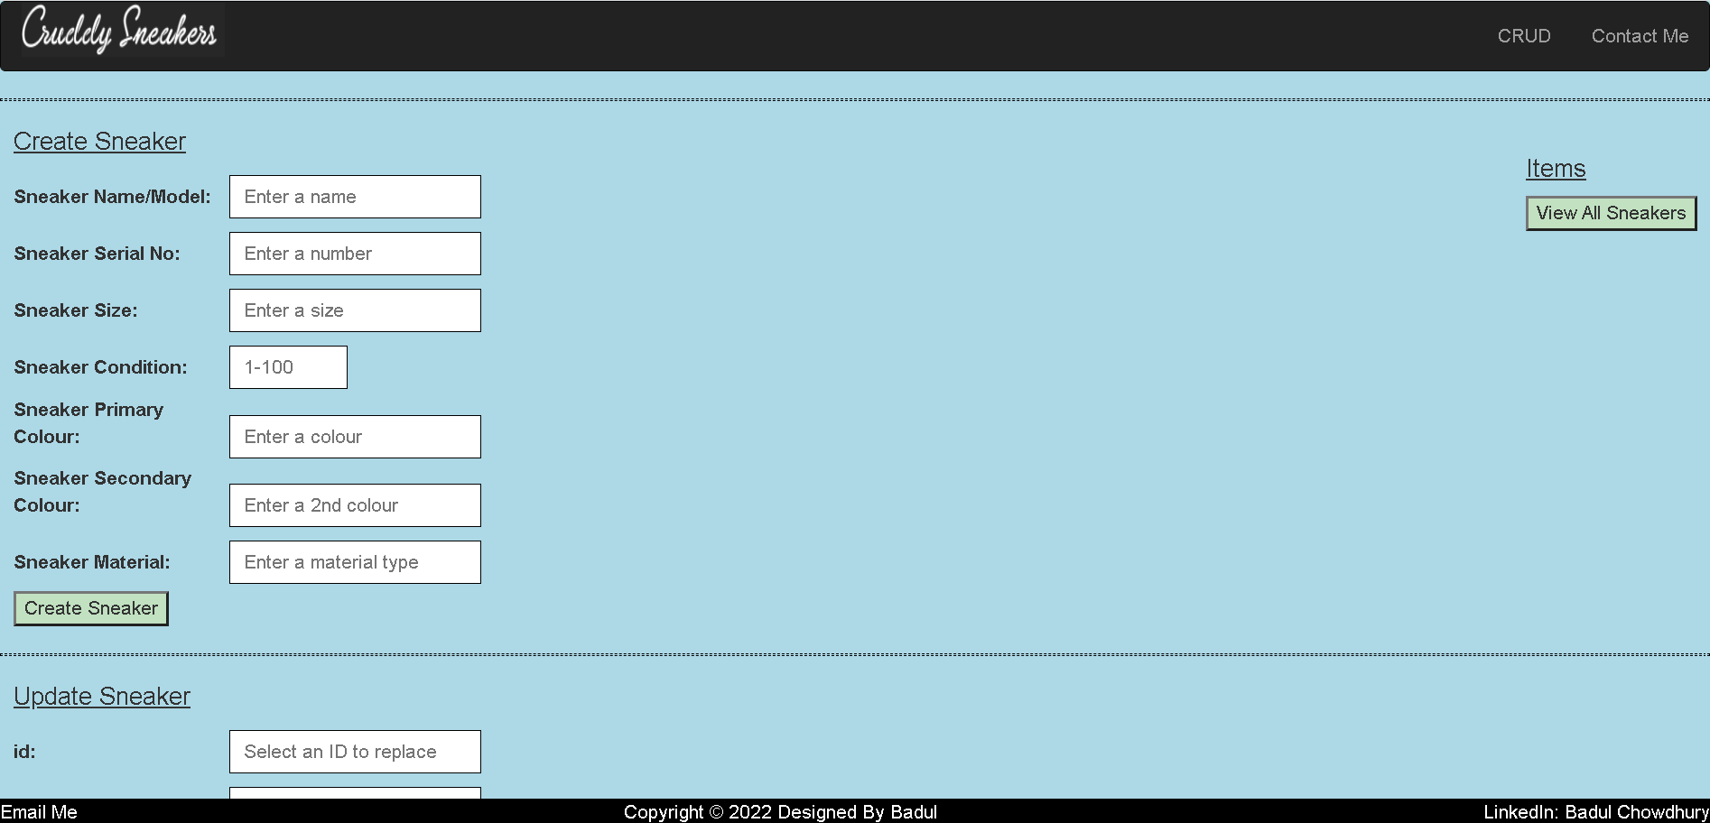
HTML – Front end MVP
A preview of what my front end looks like using HTML code

Slide 12
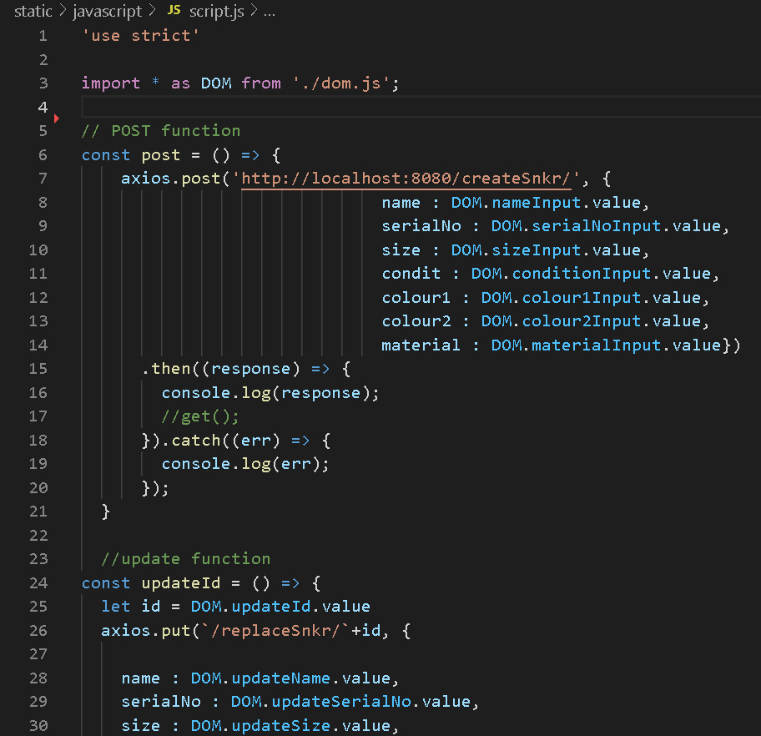
HTML – JavaScript MVP
I used a separate JavaScript to communicate between my HTML and API (back end) to send and retrieve information

Slide 13
HTML – DOM MVP
Dom or Document Object Model is another layer of my front end that is used to “listen” for interaction between the user and the application front end

Slide 14
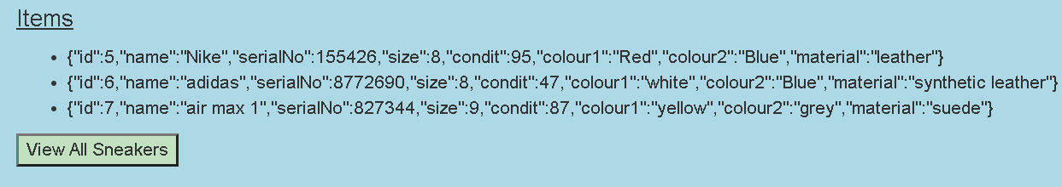
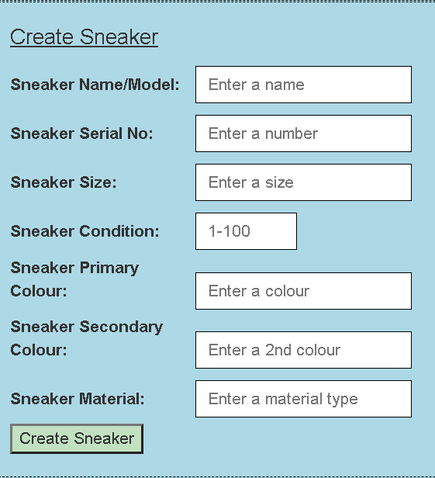
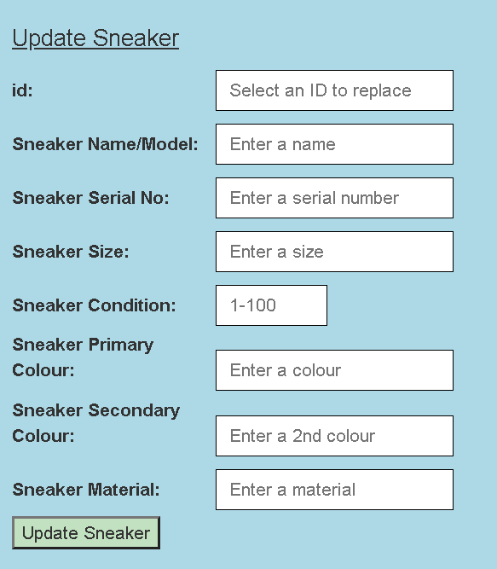
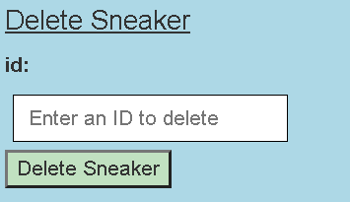
HTML screengrabs

Slide 15
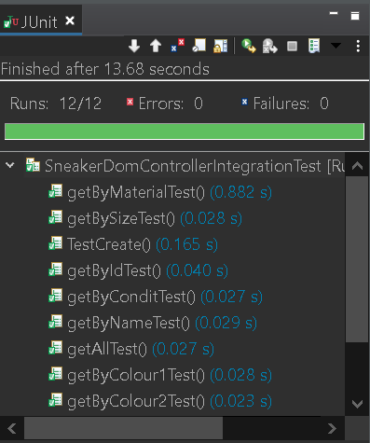
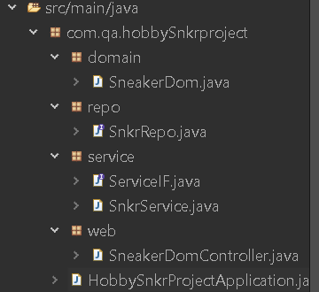
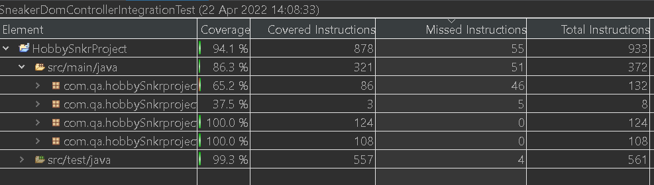
Java and testing MVP
Object Oriented Programming
Tested code coverage
Junit Integration tests for automation

Slide 16
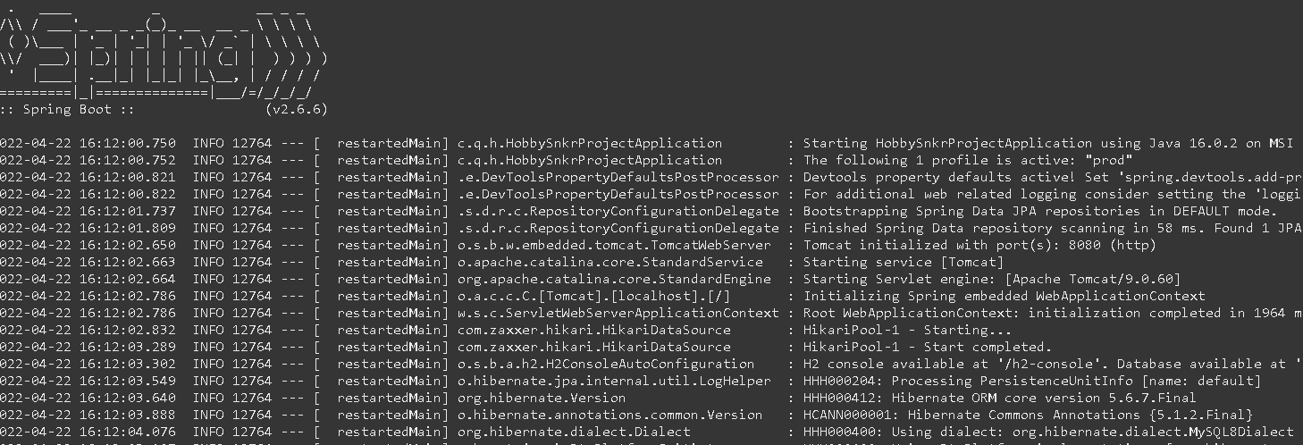
Spring REST API MVP

Slide 17
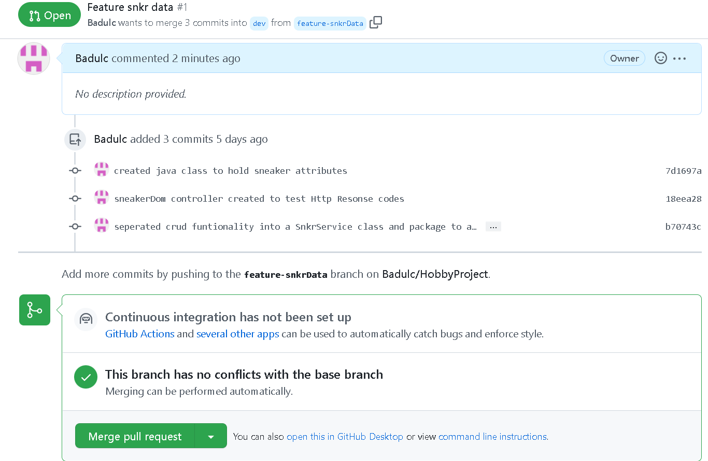
GitHub – Version Control MVP
I have used feature branches to maintain my code on GitHub allowing me to go back to previous commits and add to my code as I created committed and merged my code into a dev branch once one branch was completed

Slide 18

Challenges
Github
Due to an error on my local file system I was unable to maintain optimal version control management
To avoid future issues
Effectively manage my local file system
Increase my understanding of GitHub feature branches
To improve
Notice failures earlier on
Create commits and branches and restore my code effectively
Seek advice from colleagues/trainers about the issue without trying to resolve it alone

Slide 19
Summary – things that worked well
Java I was able to effectively build the backend of code to act as an API layer between my HTML and database manipulation | Jira I effectively used Jira to plan, produce a well thought out project management board utilizing story point estimates, MoScOw prioritization, and sprints
Front end I feel I used HTML, CSS, JavaScript to create an effective front end while adhering to OOP principles | Learning I learned about the layers involved in creating an front and back end application
Testing I created tests that were error free as well as achieving above 80% code coverage for Junit and automated Integration Tests

